Slide 1






Student Testing
and Graduation

Slide 2





SAT & ACT
History
SAT dates back to 1926
SAT “Scholastic Assessment Test”
ACT dates back to 1959
ACT “American College Testing”
SOURCE: bestcolleges

Slide 3


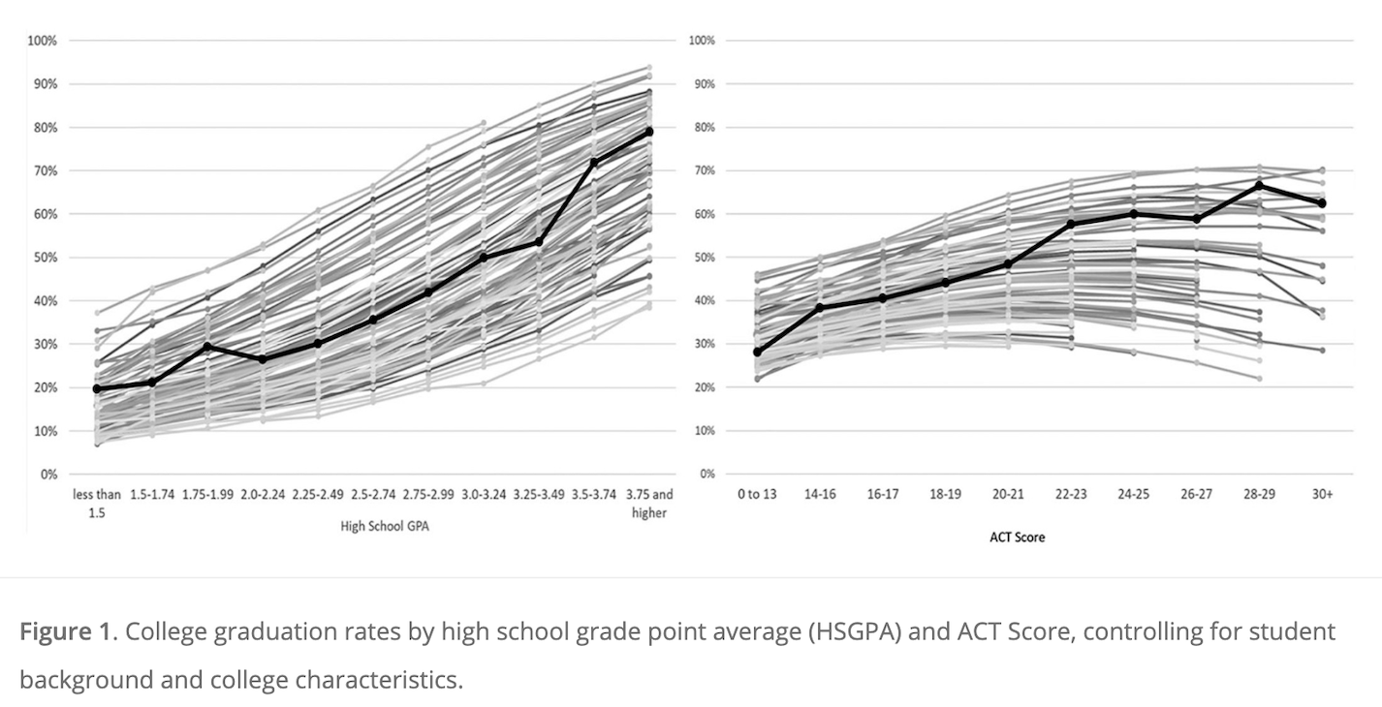




SOURCE: University of Chicago
ACT?

Slide 4




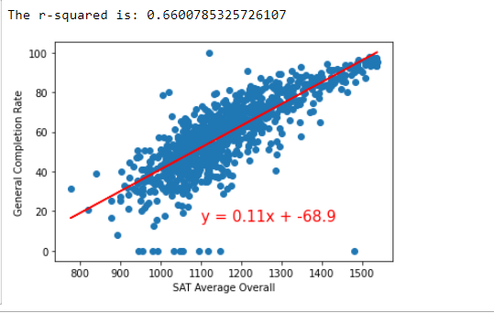







Slide 5



SAT FACTS
Higher SAT -> higher grades in college
SAT scores -> student retention into the second year
SOURCE: College Board / Reflections on a Century of College Admissions Tests

Slide 6


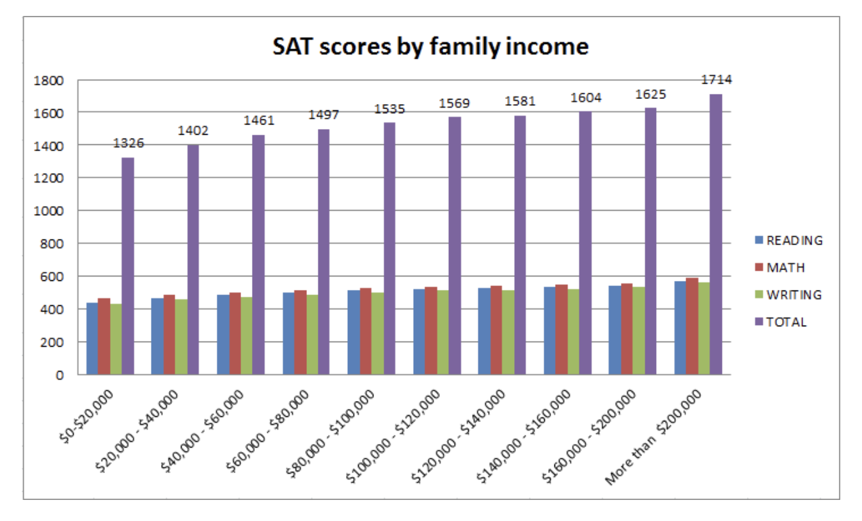

29% Increase
Lowest to Highest –> 29% increase
SOURCE: Washington Post
Notes:
Add percent increases

Slide 7


Slide 8





Graduation
Graduation correlation
Other factors (HSGPA, first gen status, income)
SOURCE: CollegeBoard/ScholarWorks
Notes:
Make this less wordy Say the same thing Remove from screen

Slide 9

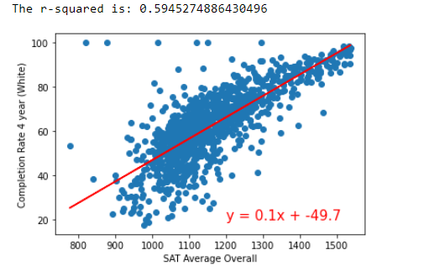

Slide 10




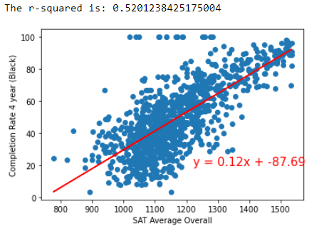



Notes:
Put log lines? Have them show on clicks

Slide 11

Notes:
Put log lines? Have them show on clicks

Slide 13
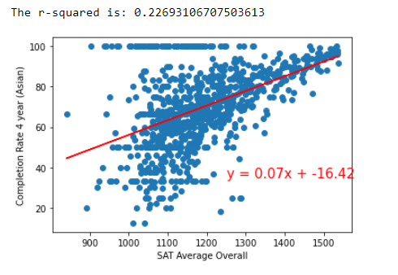




Slide 14
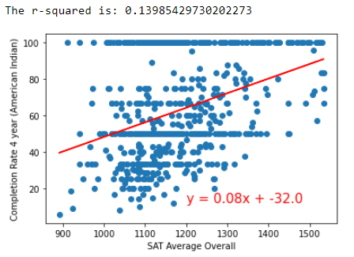
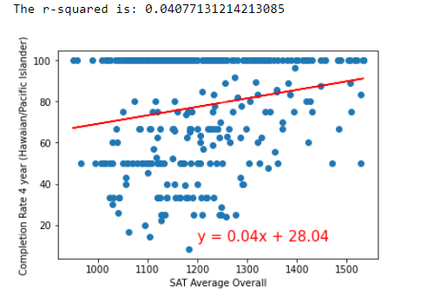

Slide 15






What is Retention?
Retention rates → Inversely proportional to admission rates
SOURCE: NCES

Slide 16
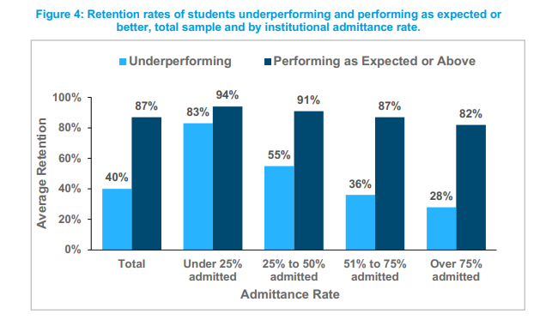
14.6% increase in retention at lower admission rates
SOURCE: College Board

Slide 17
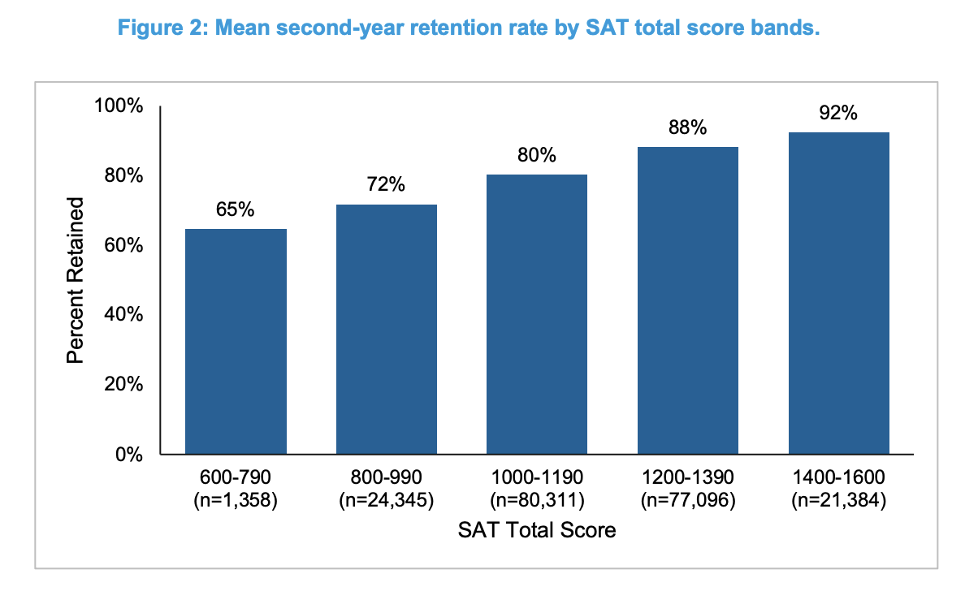
41% Increase
SOURCE: College Board

Slide 18


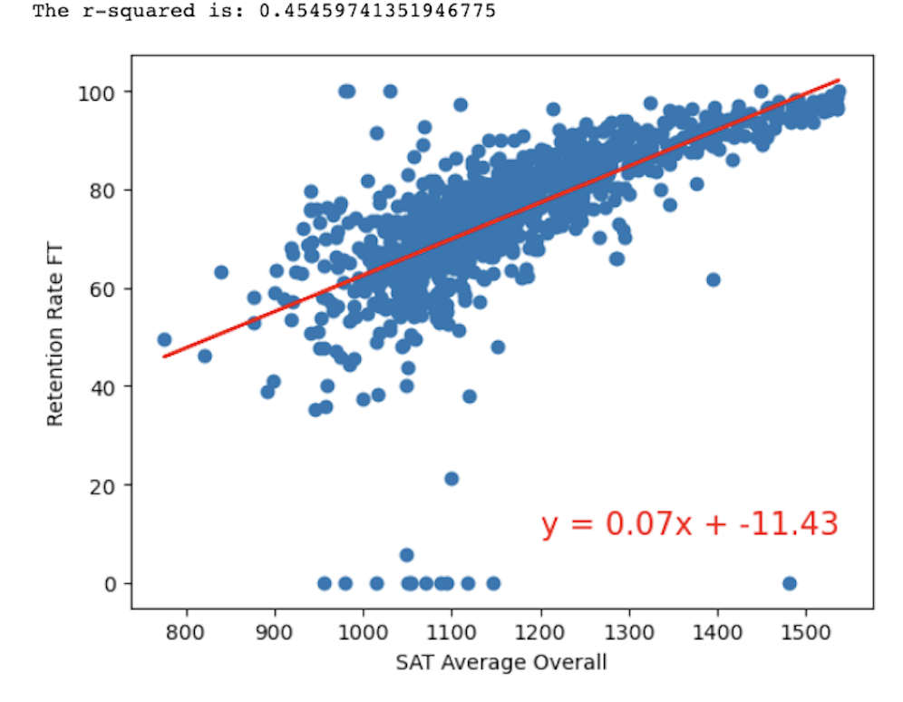
.

Slide 19






Conclusion
What Affects Student Success?
SAT Score
Median Income
ACT (Inconclusive)
Notes:
Conclusion:
What affects student success rate? SAT Score
Median Income

Slide 20









Team 11 (Team Lucyfer)
Francis Crawford
Mustafa Naeem
Isabel Sy
Isabelle Roetcisoender

